Slide 1
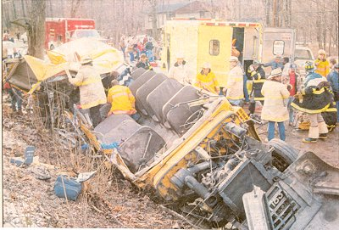
School Bus Mass Casualty Drill
Priceville Fire Department
Classroom- Tuesday May 18, 2010
Drill- Saturday June 5, 2010

Slide 2
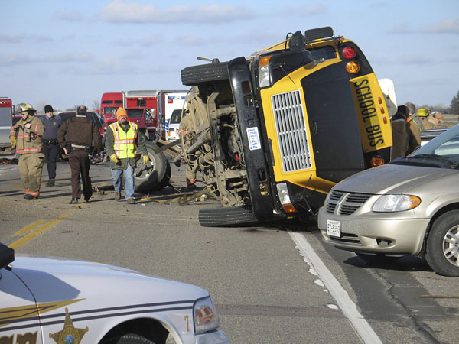
Why are we having this drill?
Everyone can do well responding to a car accident.
Everyone can take excellent care of a patient.
Everyone can safely land a helicopter.
Everyone can effectively fight a fire
Now let’s take it to the next level.
It is a good challenge to gauge where we are in our abilities to:
-Effectively utilize ICS
-Communicate efficiently
-Combine efforts of multiple agencies
This will ultimately help us expand our horizons…
Do you think we are immune from having such an accident?

Slide 3
What is a mass casualty?
A good definition is:
-“any situation where there is an imbalance of needs and resources, regardless of the number of patients”
In the past, we may have seen this, but did not use the words “mass casualty”. It might have been one fire department with a multiple vehicle accident, while having several entrapped patients. We might have called for mutual aid.

Slide 4
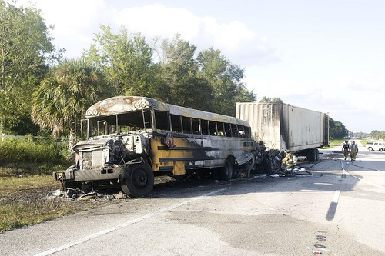
Scene safety !!!!
Scene safety is paramount. Why is that?
We must do whatever it takes to make the scene safe for patients, responders, and bystanders.
What hazards might we have to mitigate on a bus accident?
…put out fires, take care of fuel/oil leaks, down power lines, hazmat issues, stabilize vehicles, block traffic, slip/fall protection, exposed metal/debris while extricating, curious onlookers, families/friends of patients, etc…

Slide 5
Responding to scene
What resources would you be immediately calling for?
-Fire departments, EMS (how many ambulances available in our coverage area?), helicopter agencies, police

Slide 6
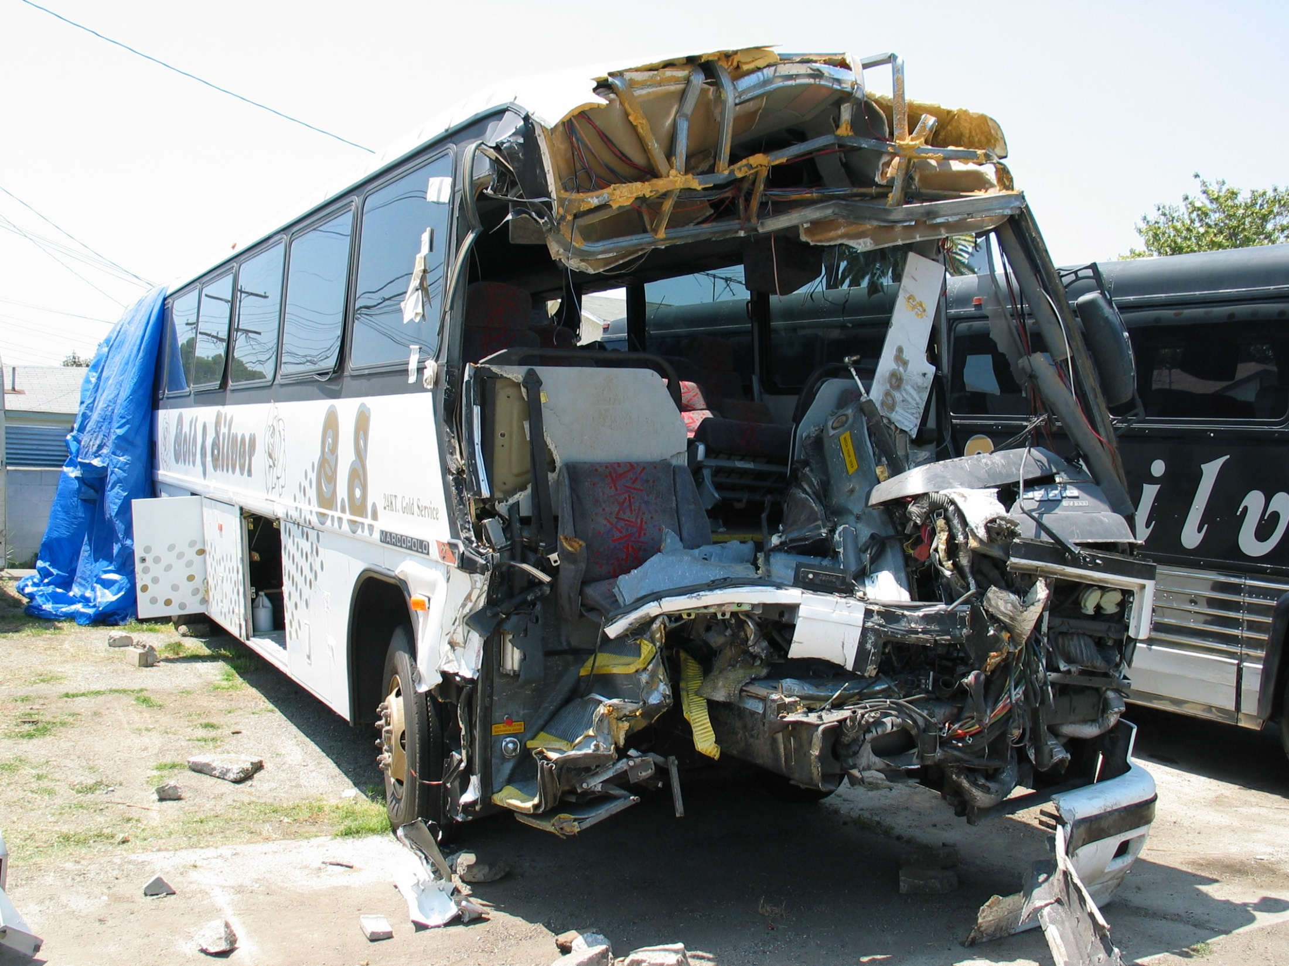

Slide 7
Arrive on scene
Don’t get tunnel-vision. Your initial instinct is to run to the bus and start treating patients. Before you do that, you need to accomplish some tasks.
Set-up incident command and do 360 of scene.
Scene size-up will be a must. PCAN (Position Conditions Actions Needs). In other words, how many patients do you have? What resources will you need? Where do you want responding units to go (staging)? What jobs will they perform?
Who is responsible for entering patients into the trauma system? Would now be the time to have Central Dispatch convey to the hospitals they will be receiving a lot of patients?
While doing all of this, it is your job to restore the scene from the chaos. You might be able to redirect bystanders to help you with simple tasks: count patients, stop traffic, keep others out until PD arrives

Slide 8
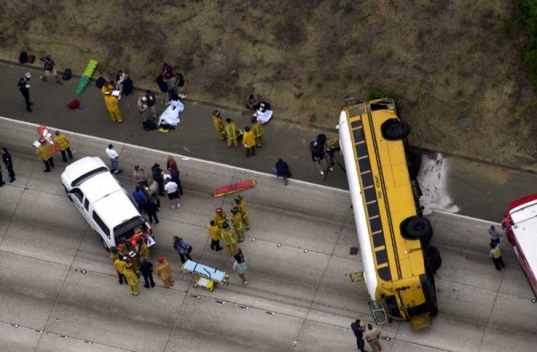

Slide 9
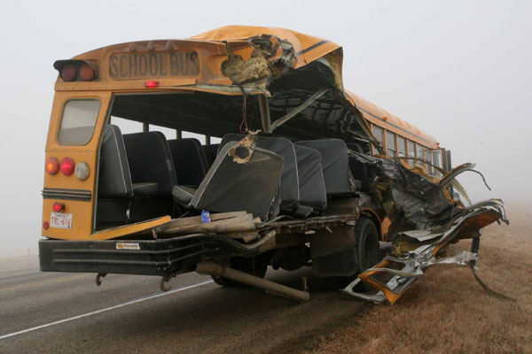
Scene Functions
What functions might we need to perform at a bus accident?
Command
Safety Officer (s)
Firefighters (for fire)
EMTs (for Patient Care)
Extrication Crew
LZ Crews
Triage Supervisor
Transport Supervisor
Communications
Stabilizing Crew
Priority 1 Area
Priority 2 Area
Priority 3 Area
Staging Supervisor
Rehab
Police (crowd/traffic)
PIO (Media and families)
Ambulance Crews
Helicopter Crews
Operations Chief
Liaison Officer
Patient Care Director
Bus Operations Director
Resource Director
Supplies
BREMS
HazMat
-Now, let’s apply this to an Incident Command
Structure

Slide 10
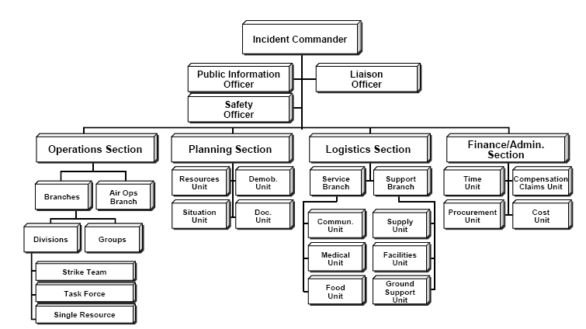
Incident Command chart
*http://en.wikipedia.org/wiki/File:ICS_Structure.PNG

Slide 11
Possible scene IC structure
Incident Command
Safety Officer
Operations Chief
PIO
Liaison
Resource Director
Patient Care Director
Bus Operations Director
Staging Supervisor
Supplies Supervisor
Rehab Supervisor
Triage Supervisor
Patient Treatment Supervisor
Transport Supervisor
Priority 1 Team Leader
Priority 2 Team Leader
Priority 3 Team Leader
Fire Team Supervisor
Stabilization Team Supervisor
Extrication Team Supervisor
LZ Coordinator
EMS Coordinator
Communications Officer
Hazmat Team Supervisor

Slide 12
Staging
According to Huntsville Fire, staging and ICS were the two initiatives that made their Lee High School bus accident flow well.
Staging is the placement of your resources off the scene- whether it is personnel, vehicles, or equipment.
Staging prevents overwhelming your scene with unnecessary resources and is used to direct resources where they are needed.
For example- during car accidents with entrapment, how many are guilty of running to where the cutting of the vehicle is occurring? Yet we regularly forget to crib the car or man the fire hose- both of those are really important jobs.
The same applies to a bus accident. You might want to have the EMTs perform patient care and firefighters perform the extrication.
As your task is finished, you report back to the staging area for re-assignment.

Slide 13
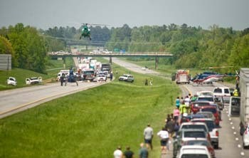
Setting-up the scene
Setting up the scene poorly can make things difficult for the rest of us. What are some things we can do to minimize the chaos?
-Staging Emergency Vehicles…
-Staging personnel…
-Setting up a clear route for EMS…
-Leave space for expansion…
-Putting triage, treatment, transport, and LZ close to each other…
-Set aside space for media and families…

Slide 14
Triage
Determined by mental status, respirations, and perfusion of blood.
Call out: “If you can hear my voice, and you can move, walk to me.”- Priority 3
No breathing, re-position airway, still no breathing, next patient- Priority 0
Irregular breathing (>30 breaths per min) or poor perfusion (no radial pulse -or- check cap refill >2 sec) or can’t follow simple commands- Priority 1
Everything else is Priority 2
Continually Triage- Patients can change status
*Chart from: http://www.cert-la.com/triage/start.htm

Slide 15
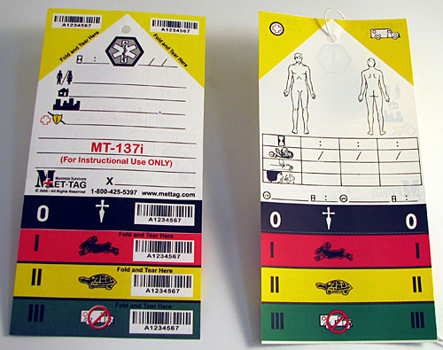
Tagging patients

Slide 16
Use of tags
The tags have places for patient’s name, address, medical condition, responder name, date, time, priority, injury locations, and vital signs.
Corners of tags can be torn off. This would be well used for patient tracking. As you put them on an ambulance, tear the corner off, put their name and destination on the tag.
If you don’t have tags, tape or sharpie in a common location is an option.

Slide 17
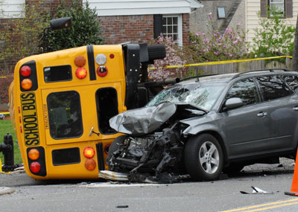

Slide 18
Patient Transport
Do we really want EMS to get involved in the patient treatment-side of a mass casualty?
How many can we fit on an ambulance? What are local EMS protocols (if there are any EMS providers in the room)?
What is THE MOST IMPORTANT JOB of the Transport Supervisor?
-Logging where the patients are going and what injuries they have

Slide 19
Resources
Somerville Fire
Decatur Fire
Hartselle Fire
Morgan County Rescue Squad
Morgan County EMA
Priceville PD
Sheriff’s Office
Somerville PD
State Troopers
City Workers
Power Company
Gas Company
County EMS
Decatur EMS
LifeCare EMS
Med-Call EMS
CR EMS
HEMSI
County Coroner
Local Government
McDonalds
Burger King
Hardees
Other Local Restaurants
Decatur General
Parkway Medical
Hartselle Medical
Huntsville Hospital
Crestwood Medical
Cullman Regional
Athens Medical
Local Gas Stations
Media- TV & Radio
Red Cross
School Buses
MCATS

Slide 20
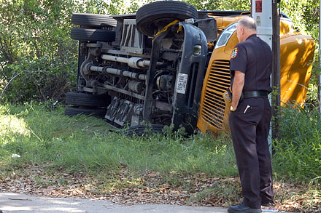

Slide 21
Difficulties- page 1
Why will communication be a difficult area?
-There will be a lot of confusion due to poor radio skills.
-Everyone wanting to talk at the same time.
-All of the responders do not have the common radio frequencies.
Who talks to Central Dispatch while on scene?
-Incident Command or those appointed by IC to do so

Slide 22
Difficulties- page 2
This one lies upon the shoulders of the Transport Supervisor
Families/friends: Be able to answer questions for them:
-Where is my child?
-What are their injuries?
-How are they getting there?
-What happened?
You will have to keep the PIO informed of all of the information for the families’ sake.

Slide 23
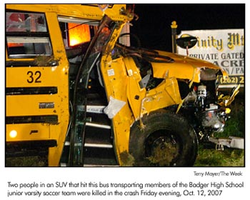

Slide 24
Difficulties- page 3
Age-specific issues:
-if you have younger kids, you will effectively have to babysit them…
-if you have older kids, you will effectively have to babysit them…
Other Issues:
--patients could tear triage tags to get different treatment or get closer to friends
--although some may be of legal age, we are still responsible if anything happens to them on our scene
--have parents sign PRT and release the kids to their custody after they fill out witness statements (ASAP). You tie-up manpower while “babysitting”.
--what about language barriers?
--Huntsville Fire used equipment (like backboards) from Madison’s Mass Casualty Trailer. How many backboards do we have as a department? How about C-Collars?

Slide 25
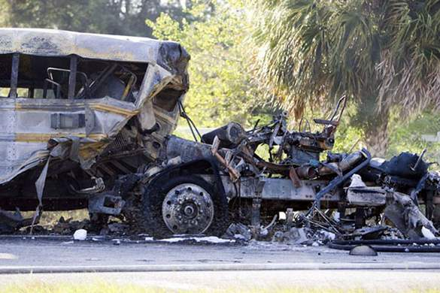
Drill specific information
Open Fire Department Safety and Instructions

Slide 26
Any questions?
The following video is about 40 minutes in length. It has very good information about the construction of buses as well as techniques for extrication and mass casualties.

